Slide 1
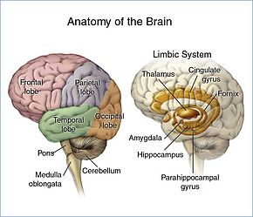
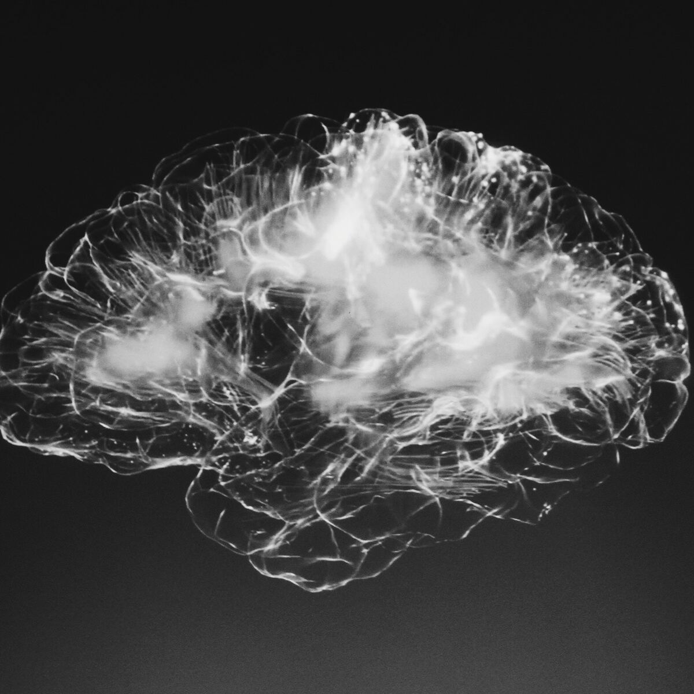
“BRAIN TUMOR DETECTION”

Slide 2
Agenda covered in presentation :
Introduction | 1
Literature Survey | 2
Problem Statement | 3
Proposed Framework | 4
Result Analysis | 5
Conclusion | 6

Slide 3
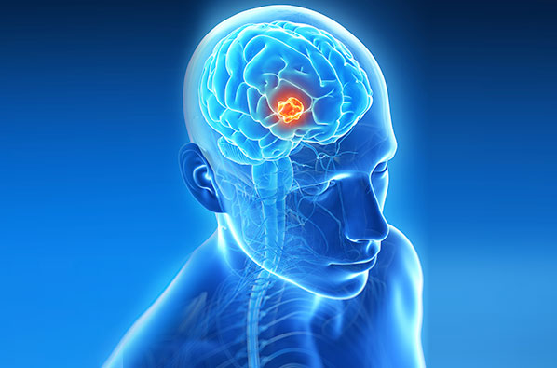
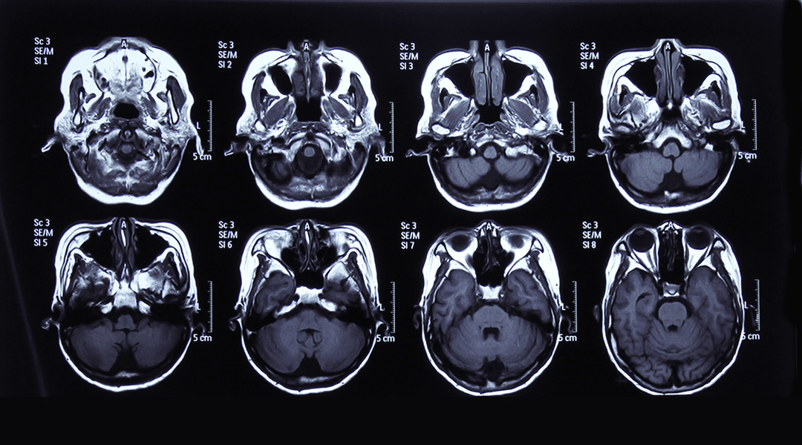
ABSTRACT:
A tumor on the brain can be divided into two cat- egories: benign and malignant. Prompt diagnosis and nurs- ing arrangement ushers to refined standard of life and ex- panded life span of these convalescents. One of the majorly effective and important course of action is to avail the Deep Neural Network (DNN). In this case the Convolutional Neural Network (CNN) was utilized to ascertain a tumor with images of the Magnetic Resonance Imaging (MRI) brain. Along with the issue of precision, we will be using the susceptibility, particularity and precision standards to as- sess network conduction. Because of the significance ofthe prognosis given by the physician, the precision of the phy- sician helping in diagnosing the tumor and medicating the sick skyrockets. In presence of the present methods will try to implement various algorithms to bring out maximum accuracy. We have implemented an algorithm called as One Hot Encoder which will classify the tumor into different types based on some key features and display the results accordingly with the type of tumor and accuracy of result.
BENIGN TUMOR
MALIGNANT TUMOR

Slide 4

INTRODUCTION:
Deep learning is a method of stratifying, combining, and fore- casting objects using a neural network trained with a large quantity of input. Deep learning produces numerous surfaces of neurons, trying to grasp the formal portrayal of largeinput in a layer wise manner. Deep Neural Network consists of three types of neural networks out of which we have used Convolutional Neural Network ( CNN ). It is a kind of deep neural network linearization as it takes input in size and pro- duces output with established size.
It is widely used in computer vision systems for object dis- cernment, stratification and semantic dissociation and is fea- sible for video and image clarifying.
Softwares likes Keras & Tensor Flow which is a highly pro- ductive interface for solving Deep Learning problems. Ten- sorFlow is an extensively utilized deep learning model de- rived from Github stars and forks and stack overflow func- tion. The majorly popular and generally availed visual connector for deep learning today is the Cameras. Keras is an advanced and prominent learning API, corresponded via Py- thon.

Slide 5
LITERATURE SURVEY:
Identification of the brain tumor takes a major role in the proposed pathway. In more recent times, the classification methodology obliges substantial utility of DL and ML algorithms. This segment introduces previous techniques and functions in differentiating brain tumor and ML-based isolation from MRI.
A.Sivaramakrishnan and Dr.M.Karnan (2013) brought forward an innovative and fruitful discovery of a brain tumor region from a brain image performed using Fuzzy C-means compilation and histogram. Histogram estimates were availed to determine the level of magnitude of the gray images. Image decompression was performed using a partial analysis system used to reduce the wavelength coefficient. The outcome of the suggested Fuzzy C-means (FCM) algorithm, fruitfully and precisely extracted the tumor area from brain MRI images.
Jaskirat kaur et al (2012), characterized integrating images, classification algorithms and evaluated various kinds of image separation techniques. They also suggested a process of differentiating and measuring contrasting integration algorithms hinging on their compatibility in different methodology. They explain the many execution limitations on which compliance will be measured.
Roy et al (2012) determines the impacted region of a tumor for scrutiny. They demonstrated its effectiveness with several data sets of contrasting tumor measurement, magnitude and whereabouts. They have demonstrated that their algorithm can intuitively ascertain a brain tumor. MR images provide a superior outcome in contrast to different methods like CT and X-ray images.

Slide 6
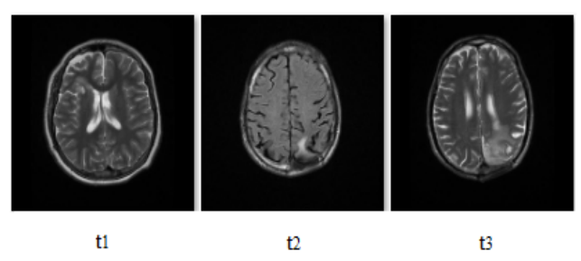
PROBLEM STATEMENT:
Sequential Model
Sequential is the easiest way to build a model in Keras. Se- quential paradigms of machine learning models add or sub- tract data sequences. It allows us to create a layer wise para- digm. We are utilizing the 'add ()' function to input layers to our paradigm. Our foremost layer is Conv2D layers. These are the layers of convolution that interact with the inserted images, which are being considered as 2-dimensional matri- ces. Activating the activation layer function. Using the acti- vation function which we will use for our first 2 layers is ReLU, or Rectified Linear Activation. This activation func- tion’s demonstrated to perform efficiently on neural net- works. Between the Conv2D surfaces and the dense surface, there exists a 'Flatten' layer. Flatten acts as a link connecting convolution and dense layers. A hidden layers is nothing but
number of hidden patterns associated between input(x) and output(y).
Zero Padding=> symmetrically adding zeroes to the input matrix
Convolutional 2D=> Calculates dot product of pixel value
Batch Normalization=> Improves performance, stability of CNN
Maxpool => A Sample based discretization process for input data.
Flattern => Pooled features mapped into single column
Dense=> ToTo connect the pooled features into connected layer.

Slide 7
PROPOSED FRAMEWORK:
Deep Learning concept has been used since we are having unstructured data. Frameworks like Keras and TensorFlow are used. Dataset has been taken from Kaggle. we have di- vided our dataset into two parts i.e Training image dataset and Testing image dataset and One Hot Encoder is used for Data Pre-Processing. The model will preprocess these images for better image quality. Pre-processing is required as it gives im- age input improvement which amplifies some pertinent im- age attributes to supplemental processing. using appropriate algorithm, Train the model with training image, and saving the model with weights. We have built a sequential model. It permits us to create a layer wise paradigm. Different layers like Conv2D, Activation, axPooling2D, Flatten and Dropout is created. After training our model with the training dataset, we are getting the accuracy of the predicted model. We are testing our model with the testing dataset and finally observ- ing the model with testing image to get final prediction.
CNN (Convolutional Neural Network)
It is an intricate paradigm that is employed to designate the tumors and is quite elaborate, therefore it requires outstand- ing analytical strength. It is also a frequently implemented neural network which is broached on specific image stratifi- cation complications. This set-up encompasses of “Seven Hidden Layers”.
Working of Model
All the necessary modules required for the detection are im- ported. We have used One Hot Encoder which is used for Data Pre-Processing. It is a customary way to preprocess the features of the categories of deep learning models. This type of coding creates a new binary feature for each probable category and allots 1 value to every test feature relevant to its foremost category. So it will classify the tumor based on its type (meningioma, glioma, pituitary and no tumor). We have built a sequential model. It permits us to create a layer wise model. So accordingly, we will get the accuracy and type of the tumor a patient has.
One hot encoding is described as the important procedure of transforming the absolute feature variables to be supplied to machine and deep learning algorithms which further enhance forecast along with stratification precision of a paradigm. One Hot Encoding is a regular method of pre-processing absolute characteristics for machine learning paradigms. This kind of encoding generates a pristine binary characteristic for every attainable criteria and allots an estimate of 1 to the characteristic of every sample that correlates to its initial criteria.

Slide 8
Environment Set-up
Importing Of Data
Data Exploration
Data Pre-processing
Sequential Model Build-Up
Tumor Classification
FLOW OF OUR MODEL

Slide 9
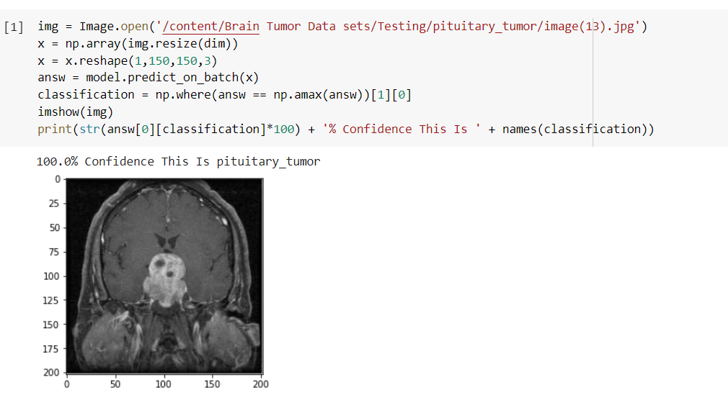
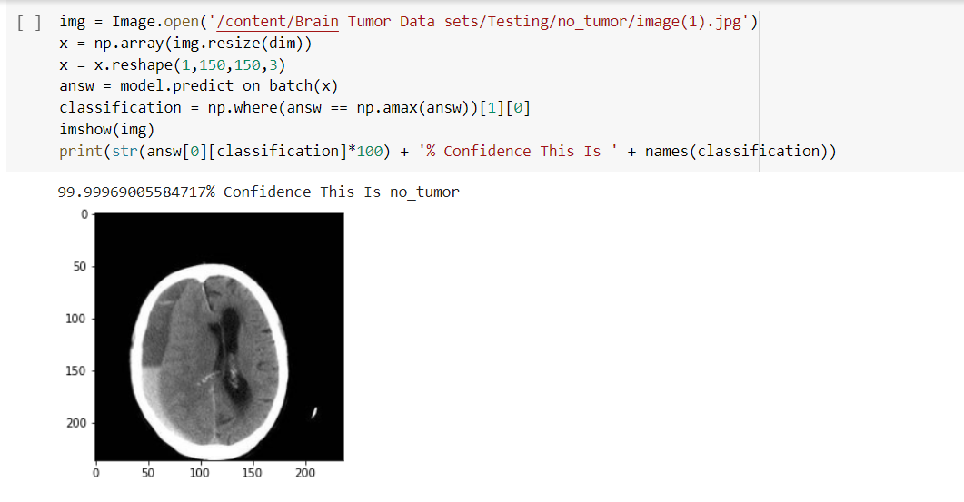
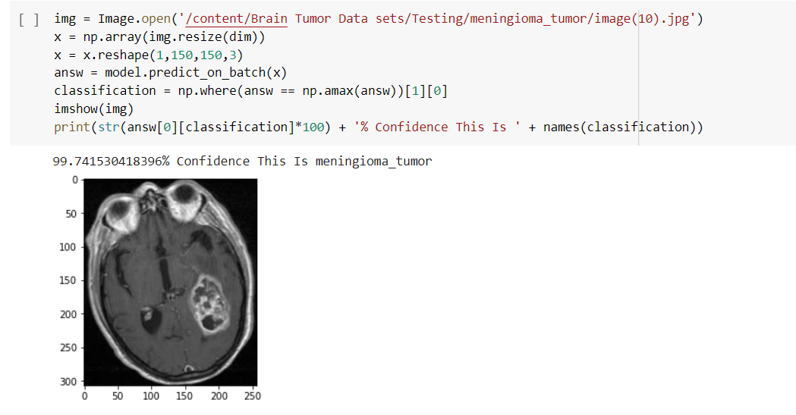
RESULT ANALYSIS:

Slide 10
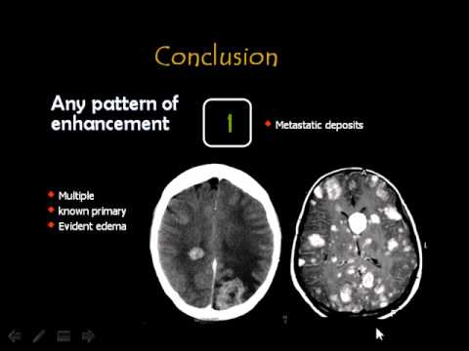
CONCLUSION:
In this venture, a latest procedure is established by the amalgamation of One Hot Encoder algorithm and CNN to ascertain tumors in brain images. CNN can detect the tumor. CNN is very helpful in selecting a default feature in diagnostic imaging.
The images collected at the centers were written by doc- tors, and the tumor examination was divided into two general classes and one patient. Because of the im- portance of the diagnosis given by the physician, the ac- curacy of the physician assisted in diagnosing the tumor and treating the patient increases the medical accuracy of the proposed method.

Slide 11
BIBLIOGRAPHY:
[1] M. Soltaninejad, et al, “Automated brain tumor detection and segmentation using superpixel-based extremely randomized trees in FLAIR MRI”, International journal of computer assisted radiology and surgery, 12(2), pp. 183-203, 2017.
[2] R. Bayot and T. Gonalves, “A survey on object classification using convolutional neural networks”, 2015.
[3] A. joshi, D. H. Shah, et al, “Survey of brain tumor detection techniques through MRI images”, International Journal of Research in Engineering and Technology, 10, pp. 586- 594, 2013.
[4] JP. Poonam, “Review of image processing techniques for automatic detection of tumor in human brain”, International Journal of Computer Science and Mobile Computing, 2(11), pp. 117-122, 2013.
[5] M. Karuna and A. Joshi, “Automatic detection and severity analysis of brain tumors using GUI in matlab”, International Journal of Research in Engineering and Technology, 10, pp. 586-594, 2013.
[6] H. Cecotti and A. Graeser, “Convolutional neural network with embedded Fourier transform for EEG classification, Pattern Recognition”,19th International Conference on. IEEE, ICPR, pp. 1-14, 2008.
[7] KS. Aboody, A. Brown, et al, “Neural stem cells display extensive tropism for pathology in adult brain

Slide 12
THANK YOU
BY –
SIDDHARATH BOHRA
CHINMAY DAUND
NEEL NIMBALKAR

